Slide 1
Link of channel
https://www.youtube.com/user/ayesha22031991/channels?view_as=subscriber
Subscribe to watch new material for logical thinking course.
You will find
Games discussion
Problem solving
Difficult problem discussion
A review if you have missed a class.
For games , watch this playlist: https://www.youtube.com/playlist?list=PLQRkqznnXfkwDnynTLSGFtEk2OBfqOzWz

Slide 2
Problem-solving Using Sets
Section 1.3
(sets are the basis of modern mathematics)
CSHU2833 - Logical Thinking – Faculty Of Information Technology, University of Central Punjab, Lahore

Slide 3
Revision
Inductive and deductive reasoning
Problem solving strategies using polya's method

Slide 4
What is a set?
Any group or collection of objects is called a set. Two common ways to define a set:
Describe a set using words. E.g., “the set of the four seasons”.
List the elements of the set inside a pair of braces { }. This is the roster method. Separate elements of the set using commas. E.g., S = {spring, summer, fall, winter}

Slide 5
Some Common sets in mathematics
Natural Numbers or Counting Numbers | N = {1, 2, 3, 4, 5, ... }
Whole Numbers | W = {0, 1, 2, 3, 4, 5, ... }
Integers | I = { ..., -4, -3, -2, -1, 0, 1, 2, 3, 4, ... }
Rational Numbers | Q = the set of all terminating or repeating decimals 1.23232323232 8.90
Irrational Numbers | R \ Q = the set of all nonterminating, nonrepeating decimals
Real Numbers | R = the set formed by combining the rational numbers and the irrational numbers
Notes:
The set of natural numbers is also called the set of counting numbers.
The three dots are called an ellipsis and indicate that the elements of the set continue in a manner suggested by the elements that are listed.
The integers …, -4, -3, -2, -1 are negative integers. The integers 1,2,3, are positive integers.
Note that the natural numbers and the positive integers are the same set of numbers.
The integer zero is neither a positive nor a negative integer.
If a number in decimal form terminates or repeats a block of digits, then the number is a rational number.
Rational numbers can also be written in the form where p and q are integers and q<> 0.

Slide 6
Useful things to know about a set
Is it well-defined? Examples:
the set of letters in the Urdu alphabet is a well-defined set
the set of the best qawwalis of Nusrat Fateh Ali Khan is not a well-defined set
How to indicate membership in a set?
The statement “4 is an element of the set of natural numbers” can be written using mathematical notation as 4 ∊ N.
The symbol ∊ is read as “is an element of”.
Negation: “is not a member of” : ∉
Notes:
A set is a well-defined set if it is possible to determine whether any given item is an element of the set.

Slide 7
Useful things to know about a set
How big is the set?
The size of a set is called its cardinality.
The cardinal number of a set is the number of elements in it. For a set S, denoted by n(S).
Example: n(S), where S is the set of the four classical seasons, n(S) = 4. Also: “S has a cardinality of 4”
Find the cardinality of the following sets:
J = {2, 5}
G = {10, 20, 30, 40, …, 80}
D = {0}
E = {2, 4, 6, 8, … }
Notes:
The last example leads to discussion of finite and infinite sets.

Slide 8
Are they the same?
Set A is equal to set B,
denoted by A ≡ B,
if and only if A and B have exactly the same elements.
{dime, nickel, quarter} ≡ {nickel, quarter, dime}
Notes:
The example clarifies that the order of the elements in the set does not matter for the purpose of determining equality. Only membership matters.

Slide 9
Universal set
The set consisting of ALL the elements about which some statements are being made.
Denoted by U.
Example 1: A news report states that due to COVID-19, US citizens are banned from travel to most countries in the world. In this case, the universal set is the set of ALL countries in the world.
Quick activity: check how many countries there are in the world.
Example 2: A blog post compares the services offered by the various telecommunications companies operating in Pakistan.
Quick activity: Use the roster method to define the universal set in this case.

Slide 10
complement of a set
The complement of a set A, denoted by A’, is the set of all elements of the universal set U that are not elements of A.
Example: “3 Brothers Mobile Shop” offers the following mobile money transfer services: { easypaisa, Jazz Cash, UBL Omni, Upaisa, Zong PayMax}
Fareeda’s preferred set of payment services, F = { UBL Omni, UPaisa }
Murad’s preferred set of payment services, M = {easypaisa, Jazz Cash, UBL Omni }
Find F’ and M’.
Note on language: compliment ≠ complement

Slide 11
The Empty Set, Ø or {}
The set with no elements.
How many natural numbers that are less than zero?
What is the cardinal number of the empty set, n(Ø) ?
What is the complement of the empty set?
What is the complement of the universal set?
Notes:
0. So, it’s an example of the empty set.
0
the universal set
the empty set

Slide 12
Blood Groups
Known facts about human blood groups:
Only A antigens (blood group A)
Only B antigens (blood group B)
Both A and B antigens (blood group AB)
No A antigens and no B antigens (blood group O)
Each person may or may not have the Rhesus factor in their blood. Blood with this factor is denoted by Rh+ and blood without it by Rh-.
Blood transfusion is safe only when the recipient has all the antigens that are present in the donor’s blood.

Slide 13
Blood Groups
For a group of people U = {Saman, Bashir, Azeem, Jaun, Afshan, Hamza, Emre, Misha, Salman},
we know that
A = {Saman, Hamza}
B = {Saman, Emre, Jaun, Afshan}
Rh+ = {Emre, Salman, Azeem, Hamza}
Organize this information in such a way that it becomes clear which person can donate blood safely to which other person in the group.
Notes:
Possible questions to show the students that it’s hard to easily interpret this data:
Is it safe for Saman to donate blood to Bashir? (No, because Bashir does not have the A antigen)
Is it safe for Azeem to donate blood to Emre? (Yes, because Azeem has neither the A nor the B antigen, and because he is Rh-positive, just like Emre)
Is it safe for Emre to donate blood to Azeem? (No, because Emre has the B antigen that Emre does not have)
Is it safe for Emre to donate blood to Jaun? (No, because even though they both only have the B antigen, Jaun is Rh-negative, while Emre is Rh-positive)
Is it safe for Afshaan to donate to Jaun? (Yes, they are both B-ve, both have the B antigen, neither has the Rhesus factor)
This should create the motivation to use better ways to visualize set data.

Slide 14
Visualizing sets with venn diagrams
U
U
B
A
A
C
Notes:
Some examples of Venn diagrams.
The rectangle represents the universal set for the case being discussed.
The oval or circular shapes represent subsets within the universal set.

Slide 15
Visualizing sets with venn diagrams
U
What set is represented by A’?
A
What set is represented by (A’)’ ?
Notes:
Some examples of Venn diagrams.
The rectangle represents the universal set for the case being discussed.
The oval or circular shapes represent subsets within the universal set.

Slide 16
Mixing them up - Intersection and union of sets
Just like the common area where two streets cross is called an intersection, the set of common elements between two sets is called the intersection of those two sets.
Just like the United States of America is a union of 50 states, the union of two sets is the set of all the elements that exist in the two sets.

Slide 17
Intersection of sets
The intersection of sets A and B, denoted by A ∩ B is the set of elements common to both A and B.
U
A
B
A ∩ B

Slide 18
Intersection of sets - worked examples
Let A = {1, 4, 5, 7}, B = {2, 3, 4, 5, 6} and C = {3, 6, 9}
Find:
A ∩ B =
A ∩ C =
C ∩ B =
Common mistake: {Ferrari, Lamborghini, Alfa Romeo} ∩ {Lamborghini, Alfa Romeo, Lancia} = Lamborghini, Alfa Romeo
An intersection is also a set.
So:
{Ferrari, Lamborghini, Alfa Romeo} ∩ {Lamborghini, Alfa Romeo, Lancia} = {Lamborghini, Alfa Romeo}

Slide 19
Disjoint sets - nothing in the Intersection
Two sets A and B are said to be disjoint if their intersection A ∩ B is an empty set, that is, if there are no elements common to both sets.
U
A
B
A ∩ B = Ø

Slide 20
Mixing them up - UNION of sets
The union of sets A and B, denoted by A ⋃ B is the set that contains all the elements that belong to both A or B or both.
U
A
B
A ⋃ B

Slide 21
Union of sets - worked examples
Let A = {1, 4, 5, 7}, B = {2, 3, 4, 5, 6} and C = {3, 6, 9}
Find:
A ⋃ B = {1,4, 5, 7, 2, 3, 6}
A ⋃ C = {1, 4, 5, 7, 3, 6, 9}
C ⋃ B = {2, 3, 4, 5, 6, 9}

Slide 22
And | oR | ∩ | ⋃
In mathematical problems involving sets, the word “and” represents intersection:
When we say the elements of sets A and B, we mean A ∩ B.
… and the word “or” represents union:
When we say the elements of sets A or B, we mean A ⋃ B.

Slide 23
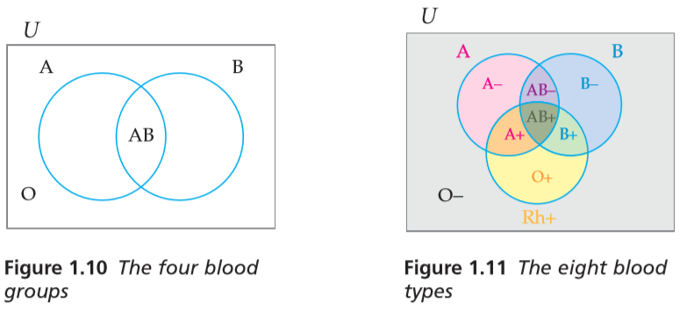
Blood Groups – using a venn diagram
Only A antigens (blood group A)
Only B antigens (blood group B)
Both A and B antigens (blood group AB)
No A antigens and no B antigens (blood group O)
Each person may or may not have the Rhesus factor in their blood. Blood with this factor is denoted by Rh+ and blood without it by Rh-.

Slide 24
Blood Groups – using a venn diagram
For a group of people U = {Saman, Bashir, Azeem, Jaun, Afshan, Hamza, Emre, Misha, Salman},
we know that
A = {Saman, Hamza}
B = {Saman, Emre, Jaun, Afshan}
Rh+ = {Emre, Salman, Azeem, Hamza}
place each person in the correct region of the Venn Diagram on the right:
Notes:
Check with the students if it’s now easy to see who can donate safely to which person?
For example:
Is it safe for Saman to donate blood to Bashir? (No, because Bashir does not have the A antigen)
Is it safe for Azeem to donate blood to Emre? (Yes, because Azeem has neither the A nor the B antigen, and because he is Rh-positive, just like Emre)
Is it safe for Emre to donate blood to Azeem? (No, because Emre has the B antigen that Emre does not have)
Is it safe for Emre to donate blood to Jaun? (No, because even though they both only have the B antigen, Jaun is Rh-negative, while Emre is Rh-positive)
Is it safe for Afshaan to donate to Jaun? (Yes, they are both B-ve, both have the B antigen, neither has the Rhesus factor)

Slide 25
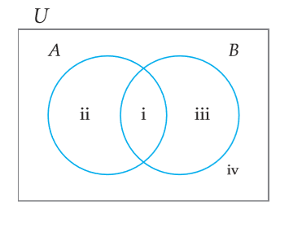
De Morgan's laws
(A ⋃ B)’ = A’ ⋂ B’ ?
(A ⋂ B)’ = A’ ⋃ B’ ?
Notes:
Proving the second part of De Morgan’s Laws can be a small class activity.

Slide 26
Checking set equality with venn diagrams
(A ⋃ B)’ = A’ ⋂ B’ ?
The universal set U has been divided up into four regions, i, ii, iii and iv
Identify the regions in:
A =
B =
A’ =
B’ =

Slide 27
Checking set equality with venn diagrams
(A ⋃ B)’ = A’ ⋂ B’ ?
The universal set U has been divided up into four regions, i, ii, iii and iv
A includes regions i and ii
B includes regions i and iii
A’ includes regions iii and iv
B’ includes regions ii and iv

Slide 28
Checking set equality with venn diagrams
(A ⋃ B)’ = A’ ⋂ B’ ?
Identify the regions in:
A ⋃ B
(A ⋃ B)’
A’
B’
A’ ⋂ B’

Slide 29
Checking set equality with venn diagrams
(A ⋃ B)’ = A’ ⋂ B’ ?
Regions identified:
A ⋃ B includes regions i, ii and iii
(A ⋃ B)’ includes region iv
A’ includes regions iii and iv
B’ includes regions ii and iv
A’ ⋂ B’ also includes regions iv
Hence (A ⋃ B)’ = A’ ⋂ B’

Slide 30
De Morgan's laws
(A ⋃ B)’ = A’ ⋂ B’
(A ⋂ B)’ = A’ ⋃ B’ ?
Notes:
Proving the second part of De Morgan’s Laws can be a small class activity.

Slide 31
Class activity: Checking set equality with venn diagrams
Can you prove that (A ⋂ B)’ = A’ ⋃ B’ ?
Notes:
Guide the students to list the regions in (A ⋂ B) and then in (A ⋂ B)’.
Then A’, B’ and A’ ⋃ B’.

Slide 32
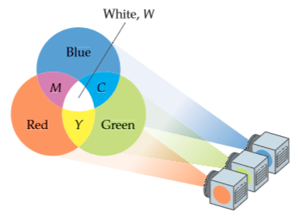
Additive Colour Mixing
Computers and televisions make use of additive colour mixing. The figure shows that when the primary colours red R, green G, and blue B are all three mixed together using additive colour mixing, they produce white, W.
Using set notation, we state this as R ⋂ G ⋂ B = W.
The colours yellow Y, cyan C, and magenta M are called secondary colours.
A secondary colour is produced by mixing exactly two of the primary colours.

Slide 33
Additive Colour Mixing
Which colour is represented by (R ∩ G’) ∩ B ?
Express the colour yellow Y in set notation

Slide 34
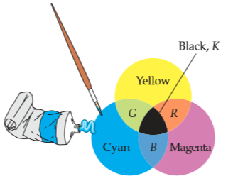
Subtractive Colour Mixing
Artists who paint with pigments use subtractive colour mixing to produce different colours.
In a subtractive colour mixing system, the primary colours are cyan C, magenta M, and yellow Y.
The figure shows that when the three primary colours are mixed in equal amounts using subtractive colour mixing, they form black, K.
Using set notation, we state this as C ⋂ M ⋂ Y = K
In subtractive colour mixing, the colours red R, blue B, and green G are called secondary colours.
A secondary colour is produced by mixing equal amounts of exactly two of the primary colours.

Slide 35
Subtractive Colour Mixing
Referring to the Venn diagram,
- which colour is represented by (C’ ∩ M) ∩ Y ?
- which colour is represented by (C ∩ M) ∩ Y’ ?
- express the colour green G using set notation
Which colour is impossible to make with this technique?
Notes:
End of Lecture 10

Slide 36
Questions for training and assessment

